Slide 1
Web Survey System
Drop Table Team;

Slide 2
Andreas SCRUM Update
Completed:
Admin Page – New Survey Tab
Implement Remainder of User Interface
Implement Question Selection Functionality
Validate User Input & Selections
http://www.rrsurvey.net/createsurvey.php

Slide 3
Andreas SCRUM Update
Work for This Week:
Admin Page – New Survey Tab
Submit New Survey to Database
Implement Email Functionality
Prepare the Admin Page File
Combine Elements of Admin Page

Slide 4
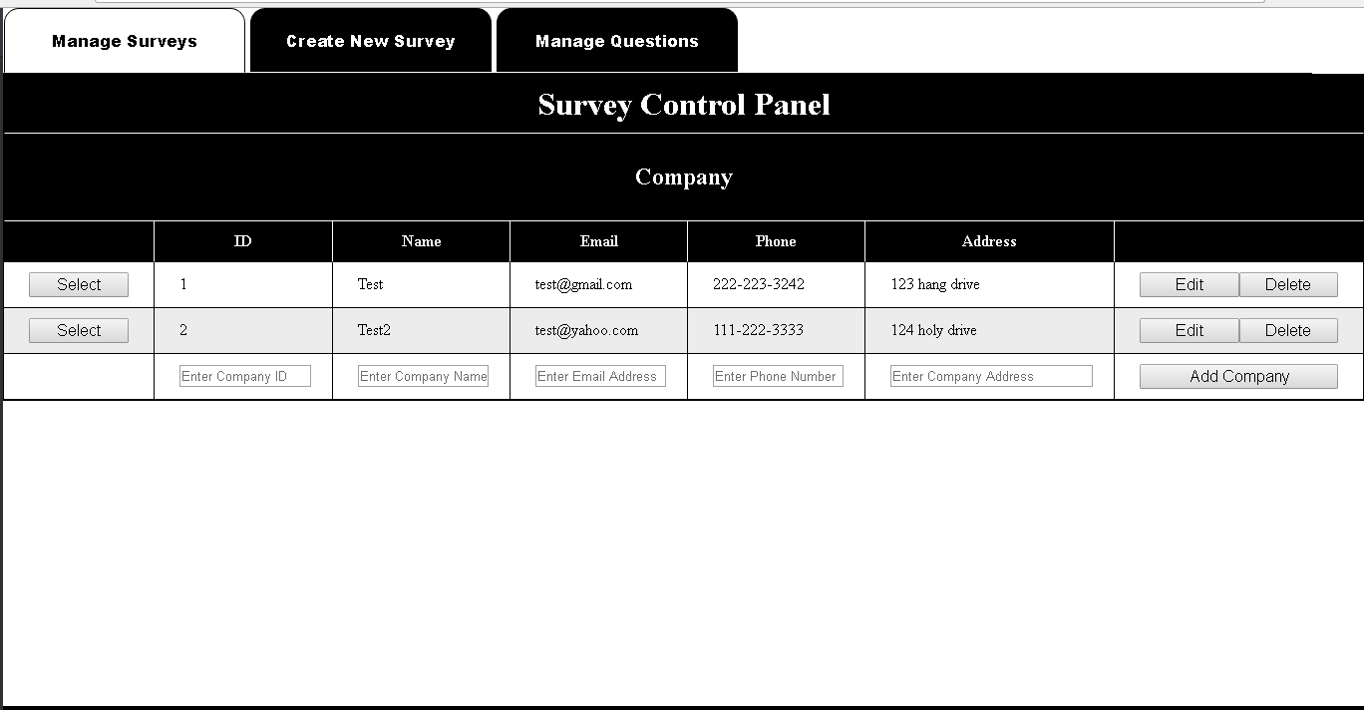
Billy Scrum Update
Completed:
Admin Page – Manage Survey Tab
Generate Report
Able to add, delete, and edit on the same page

Slide 5
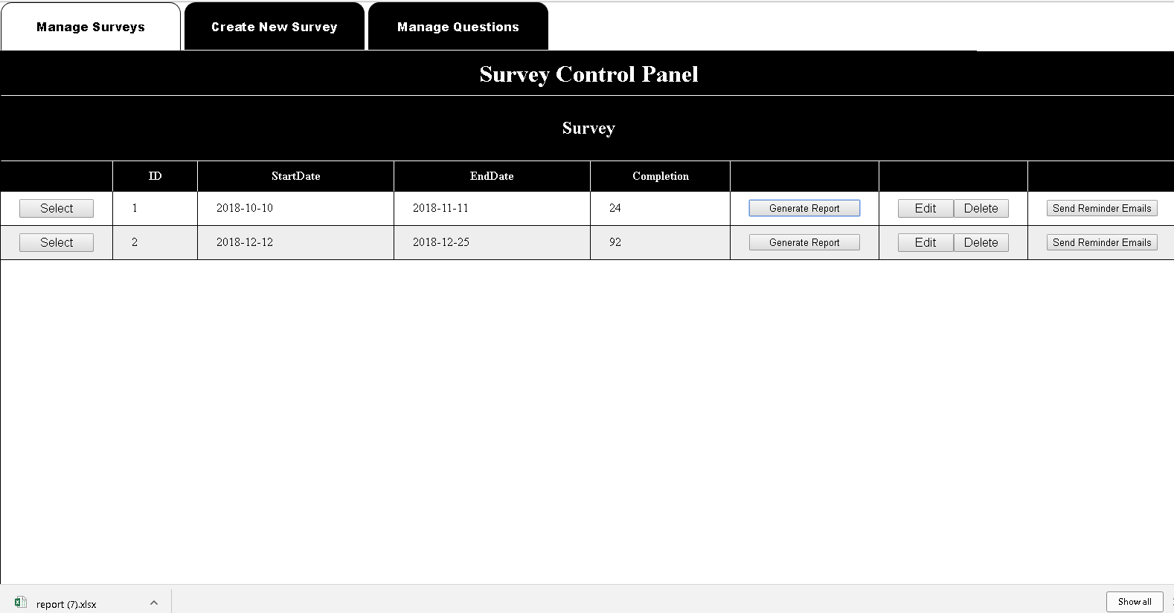
Billy Scrum Update

Slide 6
Billy Scrum Update
Issues Encountered:
Admin Page – Manage Survey Tab
Saving Added Data To Database
Navigation Between Views

Slide 7
Billy Scrum Update
Work for This Week:
Admin Page – Manage Survey Tab
Navigation Between Views
Implementing Reminder Emails
Fixing the Update Feature

Slide 8
Christian Scrum Update
Completed:
Admin Page – Manage Survey Tab
Implemented PHPSpreadsheet Library to Web Server.
Excel file creation functionality

Slide 9
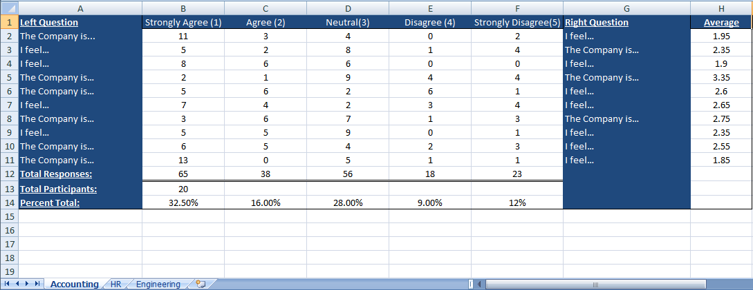
Christian Scrum Update

Slide 10
Christian Scrum Update
Issues Encountered:
Admin Page – Manage Survey Tab
Excel Sheet output layout
Data displaying and formatting

Slide 11
Christian Scrum Update
Work for This Week:
Admin Page – Manage Survey Tab
Generate Report Charts
Finalize User Authentication/Page Security

Slide 12
GERALD SCRUM UPDATE
Issues Encountered:
Admin Page – Manage Survey Question Tab
Implement Edit / Add Functionality
Connection to Database - Struggling with jQuery
Integrate the Tab View to the Admin Page
Haven’t gotten to begin work here yet

Slide 13
GERALD SCRUM UPDATE
Work for This Week:
Admin Page – Manage Survey Question Tab
Complete the issues mentioned on the previous slide
Implement Email Script
Implement Automated Emailing

